Slide 1

Practice. Loading data sets
We have to load into Rcommander the dataset osteoporosis.csv
“.csv” -> “comma separated values” but could be separated with \tab, spaces, ; , ….
First of all “look” the file with a file viewer like “wordpad”, “bloc de notas”,…

Slide 2
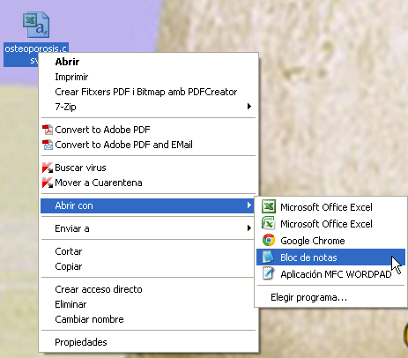
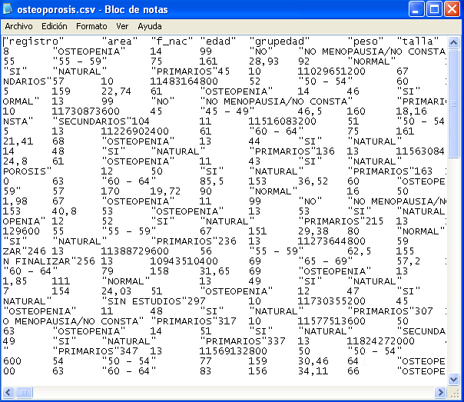
Practice. Loading data sets
We have to load into Rcommander the dataset osteoporosis.csv

Slide 3
Practice. Loading data sets
We have to load into Rcommander the dataset osteoporosis.csv
“.csv” -> “comma separated values” but could be separated with \tab, spaces, ; , ….
First of all “look” the file with a file viewer like “wordpad”, “bloc de notas”,…
Once we know how:
the data is separated
How the decimals are separated
we can open with Rcmdr

Slide 4
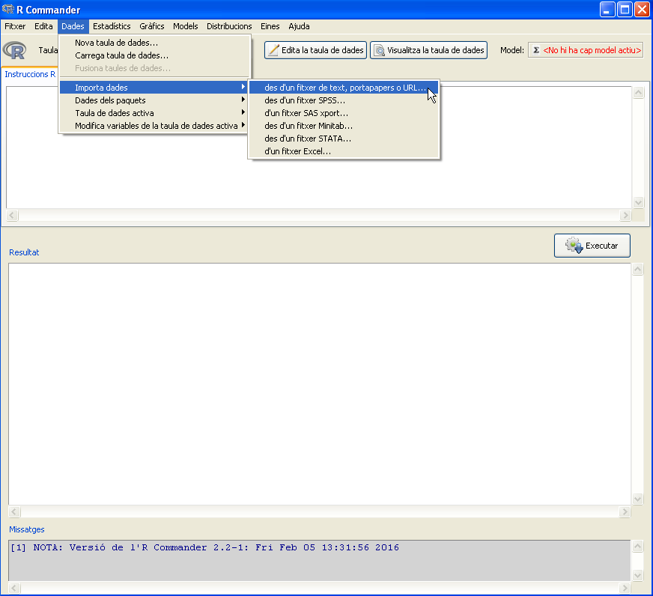
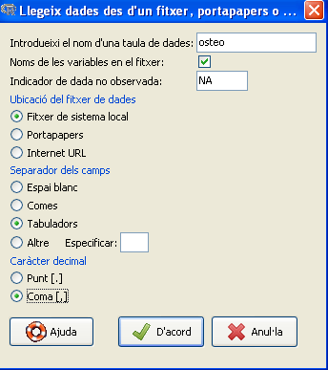
Practice. Loading data sets
We have to load into Rcommander the dataset osteoporosis.csv

Slide 5
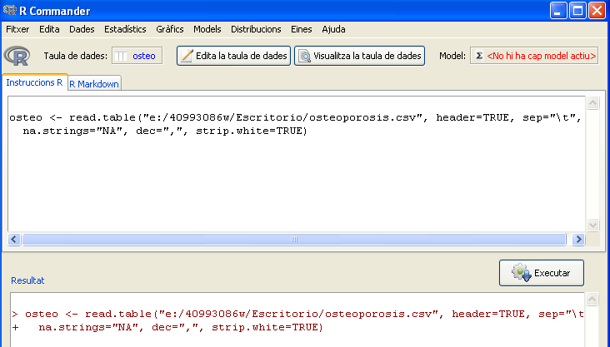
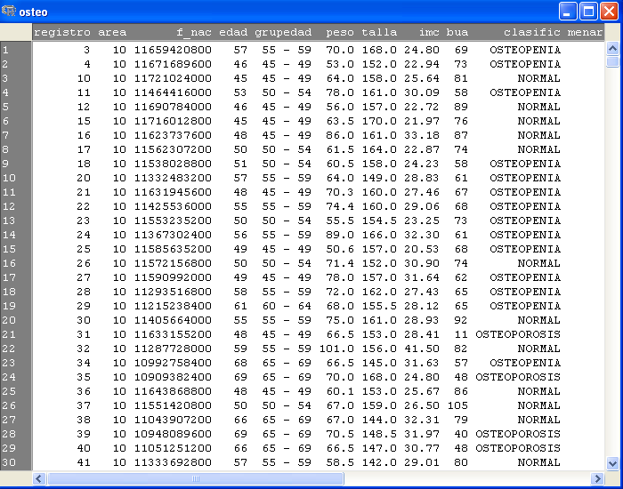
Practice. Loading data sets
We have to load into Rcommander the dataset osteoporosis.csv

Slide 6
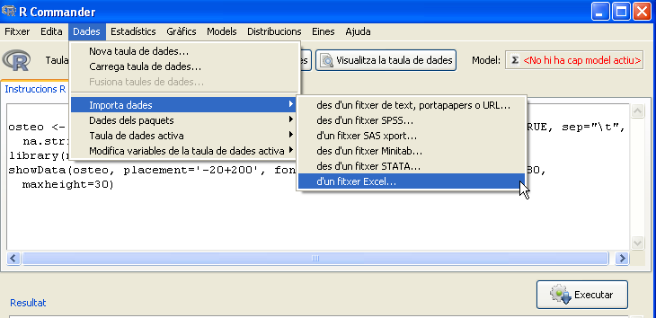
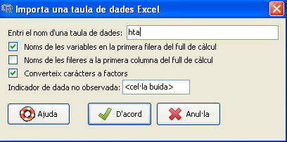
Practice. Loading data sets
We have to load into Rcommander the dataset hta.xls

Slide 7
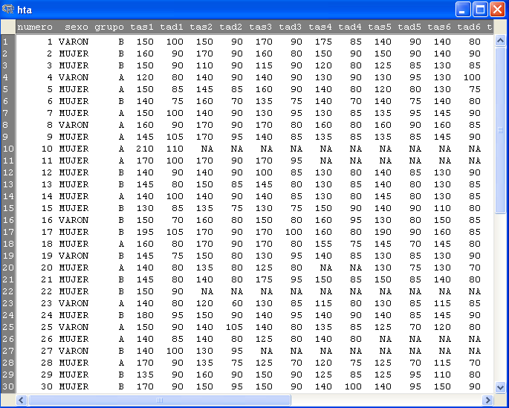
Practice. Loading data sets
We have to load into Rcommander the dataset hta.xls

Slide 8
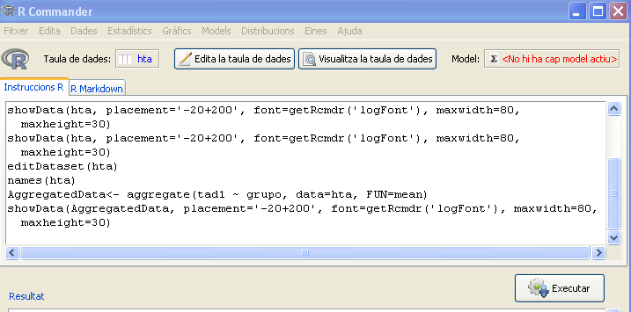
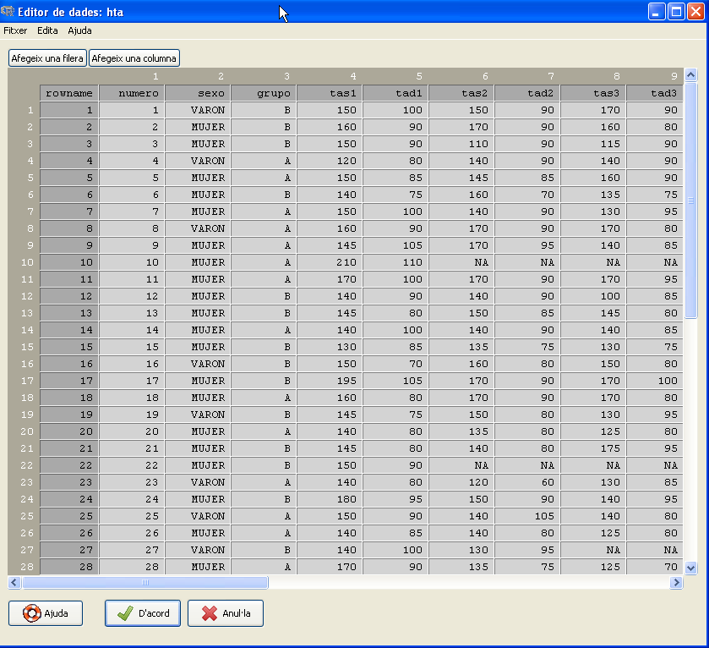
Practice. Adding variables to the dataset
We have to add variables age and weight the dataset hta.xls

Slide 9
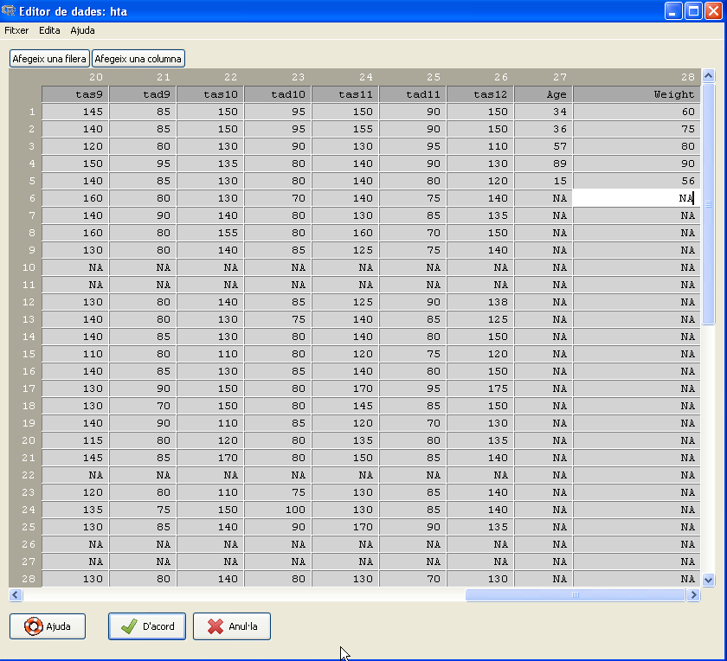
Practice. Adding variables to the dataset
We have to add variables age and weight the dataset hta.xls

Slide 10
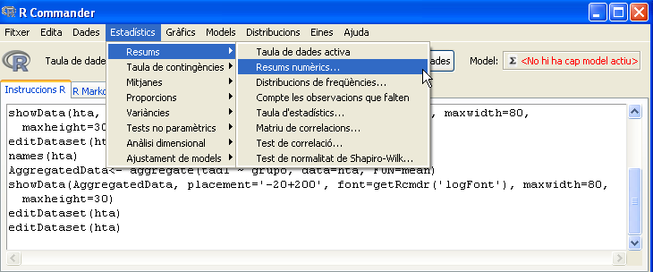
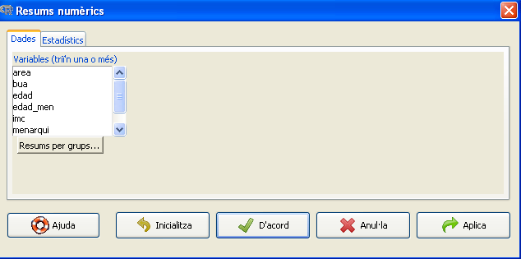
Practice. Statistics with Rcmdr
We have to calculate some descriptive statistics with the dataset osteo.

Slide 11
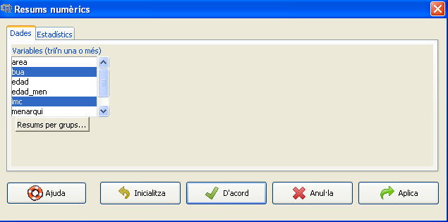
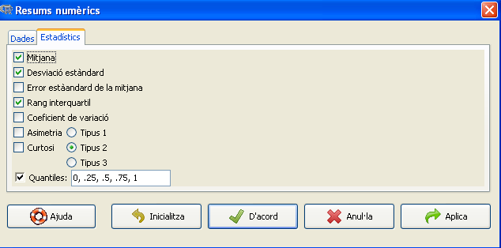
Practice. Statistics with Rcmdr
We have to calculate some descriptive statistics with the dataset osteo.

Slide 12
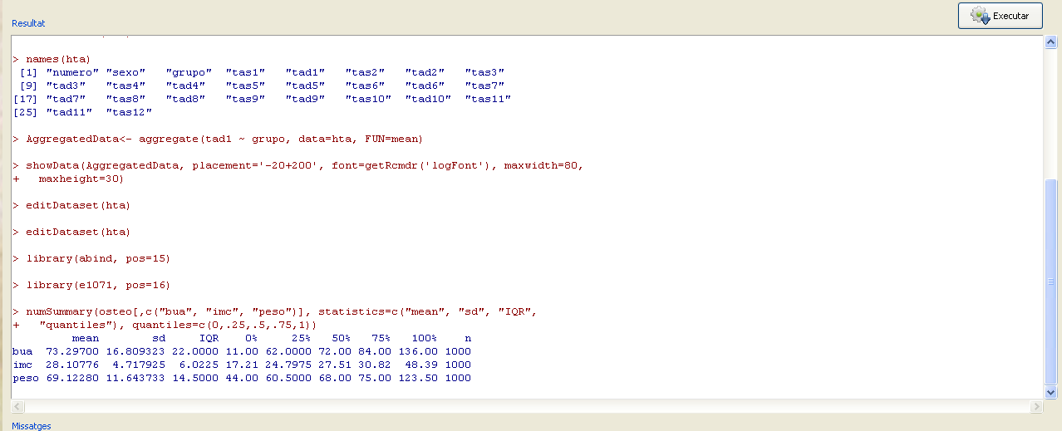
Practice. Statistics with Rcmdr
We have to calculate some descriptive statistics with the dataset osteo.

Slide 13
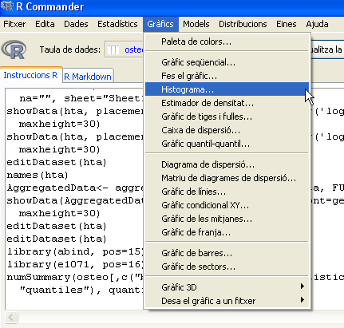
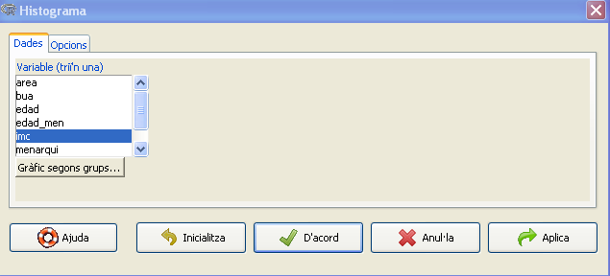
Practice. Graphics with Rcmdr
We have to see how the variable imc is distributed among the individuals

Slide 14
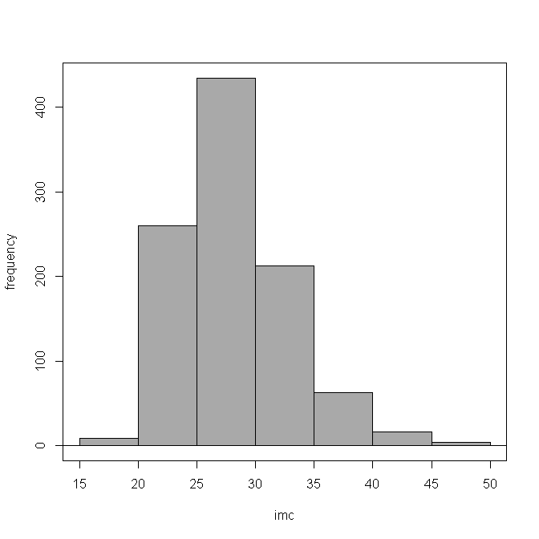
Practice. Graphics with Rcmdr
We have to see how the variable imc is distributed among the individuals

Slide 15
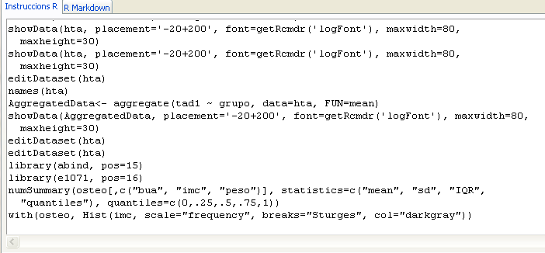
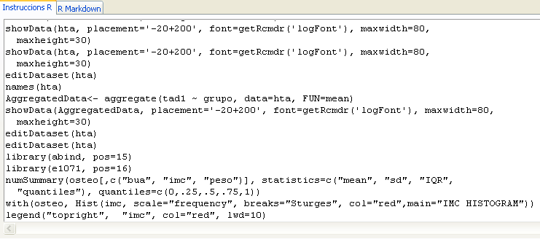
Practice. Running scripts with Rcmdr
We want to change the graphic colour, add a legend and a main title

Slide 16
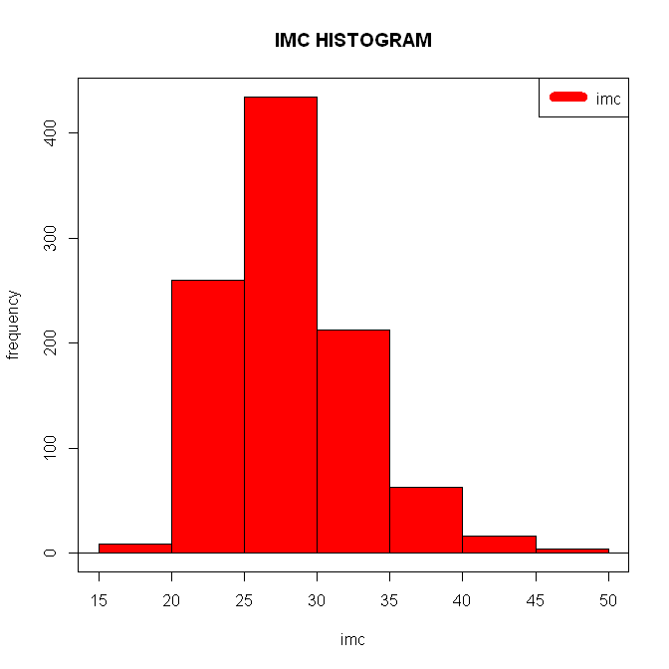
Practice. Running scripts with Rcmdr
We want to change the graphic colour, add a legend and a main title

Slide 17
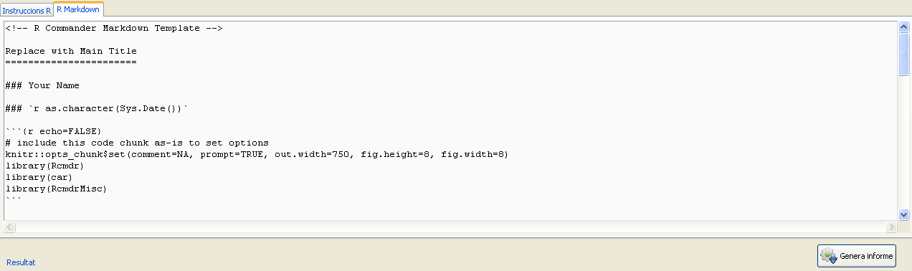
Practice. Export the results
We want export the results

Slide 18
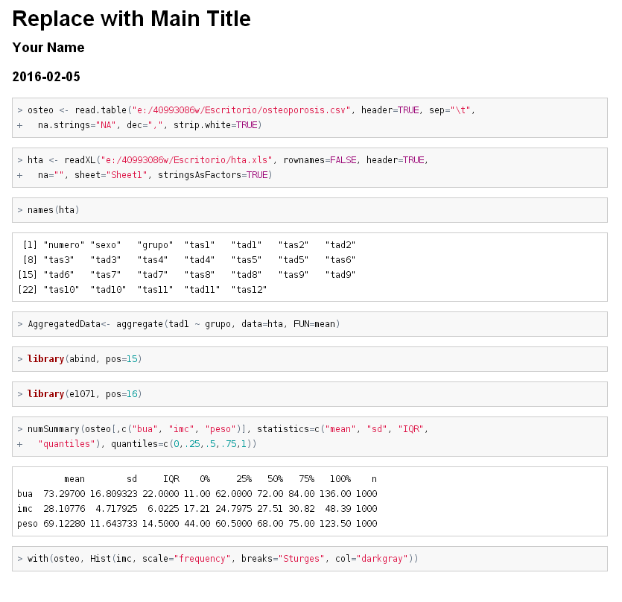
Practice. Export the results
We want export the results

Slide 19
Exercise
Load into Rcmdr the dataset in prostate.csv
Calculate some descriptive statistics for some variables
Make a graphic from one or two variables
Generate the report with all the data

